Slide 1
Predicting upcoming information in native-language and non-native-language auditory word recognition
Dijkgraaf, A., Hartsuiker, R. & Duyck, W. (2016)
Hannah Gauditz
Linguistics and Language Processing:
Lab Rotation Eye-Tracking
22-11-2023

Slide 2
Table of Content
Introduction
Relevant Topics
Goals, Research Questions, Hypotheses
Methods
Participants
Visual World Paradigm
Procedure
Analysis & Results
Discussion

Slide 3
1
Introduction
Relevant Topics
Goals, Research Questions, Hypotheses

Slide 4
Relevant Topics
Prediction in comprehension:
sentence context preactivates representation of target word
facilitatory in language processing
L2:
slower processing, less accurate, more resource-consuming than L1
anticipatory behaviour similar to L1 or incremental integration of speech?
modulated by factors associated with non-native comprehension (e.g. weaker representations, lexical competition)?
dependent on similarity of L1 and L2?
dependent on proficiency in L2?
use of verb semantics and morphosyntactic features as prediction cue?
weaker link hypothesis: bilinguals have less practice in both languages than monolinguals

Slide 5
Goals, Research Questions, Hypotheses
Goals:
investigate use of verb semantics to predict upcoming information in native and non-native language
comparison between-participants (monolinguals vs. bilinguals) as well as within-participants (L1 vs. L2 in bilinguals)
Research questions:
Does predictive language processing occur to the same extent when bilinguals listen to their L1 compared to listening to L2?
Do bilinguals use prediction to the same extent as monolinguals?
Hypotheses:
Bilinguals listening in L2 do not predict semantic properties of upcoming referents as fast and to the same extent as when listening in L1.
Bilinguals listening in L1 do not predict semantic input to the same extent as monolinguals do in L1.
Bilinguals with a higher proficiency score show a stronger prediction effect than bilinguals with a lower proficiency score.

Slide 6
2
Methods
Participants
Visual World Paradigm
Procedure

Slide 7
Participants
Bilinguals:
30 bilinguals (men: 5, women: 25, mean age: 24 years, age range: 20-41)
L1: Dutch
L2/L3: English (LexTale: high proficiency)
Monolinguals:
30 native speakers of English (men: 4, women: 26, mean age: 20 years, age range: 18-28)

Slide 8
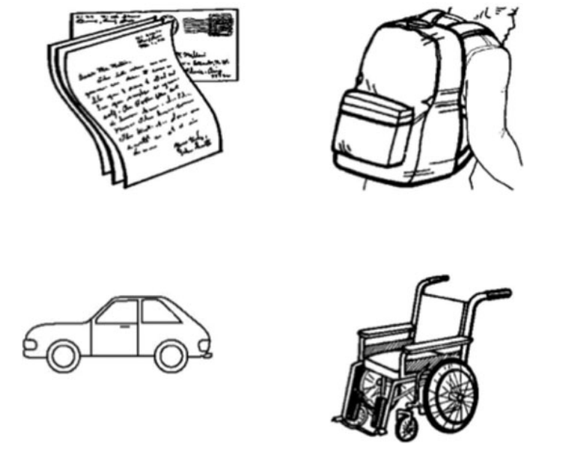
Visual World Paradigm
Mary reads a letter.
Mary steals a letter.
Stimulus sets: 36 picture arrays , two Dutch sentences and translation equivalents in English
18 experimental sets: one constraining sentence, one neutral sentence
18 filler sets: sentences could apply to no, two or three objects
assigned to two stimulus lists
Pictures:
standardized line drawings
object names matched for frequency, phoneme counts, syllable counts, orthographic dissimilarity
randomized location in array
Sentences:
four-word SVO sentences with constant subject, article could not be used as prediction cue
recorded by female native speaker of Dutch with English as L2
recording frames (verb offset – noun onset) matched by length across languages

Slide 9
Procedure
participants were seated in front of screen, received written and verbal instructions without explicit task
eye movements: right eye, Eyelink 1000 eye tracker (sampling frequency: 1000 Hz)
2 practice trials, 2x18 experimental trials:
fixation cross (500 ms)
presentation of picture array
auditory stimulus after 2200ms
drift correction if necessary
completion of additional tests :
LexTALE Dutch, LexTALE English, LEAP-Q language background questionnaire
additionally for bilinguals: backward translation of English verbs and nouns

Slide 10
3
Analysis & Results

Slide 11
Analysis & Results
Statistical analysis:
exclusion: no correct translation of verb (18 trials)
time frame: 350ms after verb onset - 200ms after noun onset
50ms time bins with fixation on target, averaged over subjects and items
additionally: first 400ms of time frame aggregated into 100ms time bins to test effect of conditions per group
linear mixed effect models:
random factors: participant, sentence, target image
fixed factors: condition, language, list, block, listener type
with vs. without LexTALE scores to test effects of English proficiency

Slide 12
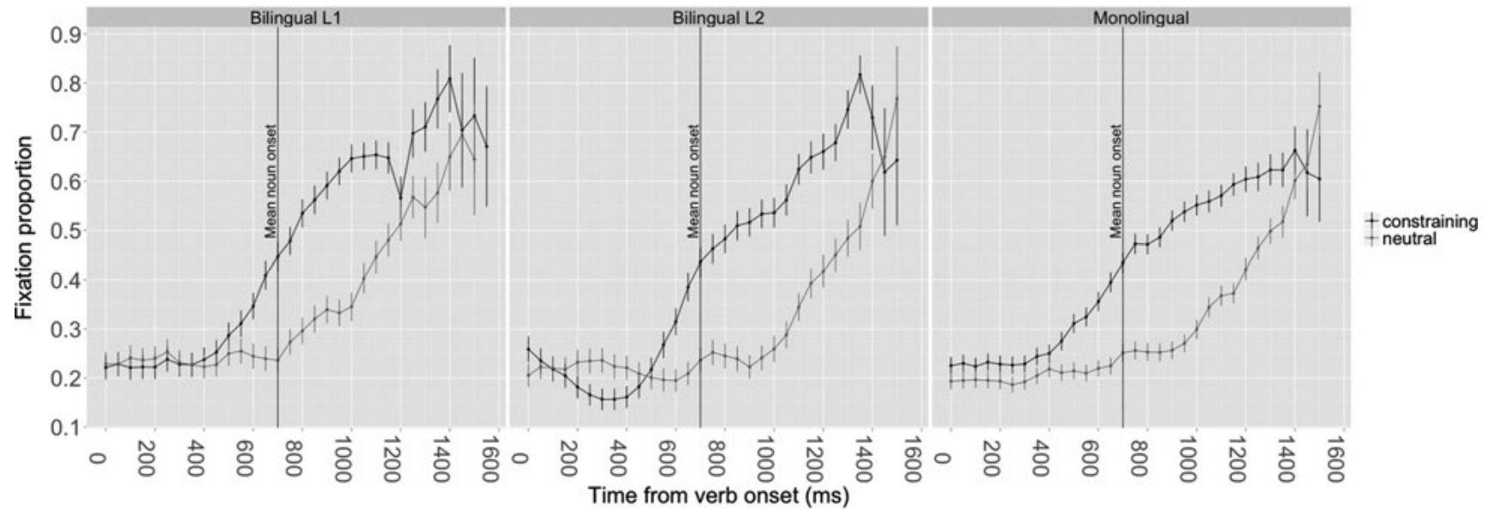
Analysis & Results
Findings:
significantly higher fixation rate on target in constraining condition than in neutral condition, fixation proportions diverge before mean noun onset time
comparable magnitude of target fixations within bilinguals and compared to monolinguals
no interaction between language/listener type and condition, no effect of proficiency
bilinguals predicted upcoming information slightly slower than monolinguals

Slide 13
4
Discussion

Slide 14
Discussion
Interpretation & placement in literature:
bilinguals use verb semantics to predict upcoming input similarly in native and non-native comprehension and compared to monolinguals
slightly different prediction speed of bilinguals and monolinguals consistent with weaker link hypotheses
no modulation of prediction effect in L2 by factors associated with non-native processing nor by language proficiency
predicition in L2 possibly facilitated by similarity of languages
Limitations:
lack of power in bilingual group
no indication of speech rate
Future research:
Under which circumstances is predictive language processing retained in L2 and when is this not the case?
Does increased processing speed decreases the ability to use semantic information for predictions in L2?
How does the strength of non-native accents affect prediction in L1 and L2?

Slide 15
Take-Home Message
Topic: Predictive language processing in non-native and native comprehension
Method: VWP with constraining and neutral descriptive sentences, recording of eye movements
Results:
increased fixation rate towards target in constraining condition
similar prediction process across languages and listener types
weaker link hypothesis: slightly slower prediction in bilinguals
Conclusion: Proficient bilinguals use verb semantics in non-native listening to restrict the expected domain of referents to the same extent as bilinguals and monolinguals do when listening to their native language.

Slide 16
References
Dijkgraaf, A., Hartsuiker, R., & Duyck, W. (2017). Predicting upcoming information in native-language and non-native-language auditory word recognition. Bilingualism: Language and Cognition, 20(5), 917-930. doi:10.1017/S1366728916000547

Slide 17
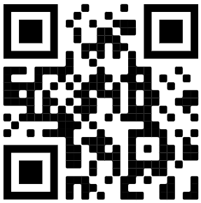
Thank you!
Hannah Gauditz
Linguistics and Language Processing:
Lab Rotation Eye-Tracking
22-11-2023

